Slide 1
Variant calling
Notes:
Change to new NBIS logo

Slide 2
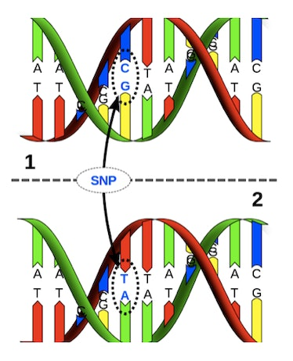
Genetic variation
Genetic variation
differences in DNA among individuals of the same species:
Single nucleotide variants (SNVs)
Small insertions and deletions (indels)
Structural variants (SVs)
Copy Number Variants (CNVs)
Variant calling
Identify genetic variations compared with a reference sequence in NGS data
SNV
Notes:
Genetic variation range in size from large chunks of the chromosome down to single nucleotides. We will focus on SNVs and short insertions and deletions in todays exercise.

Slide 3
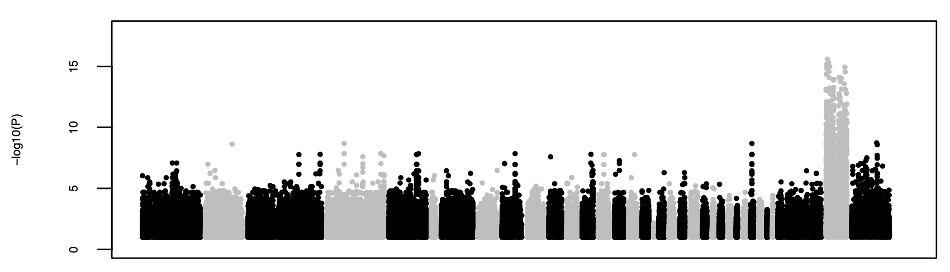
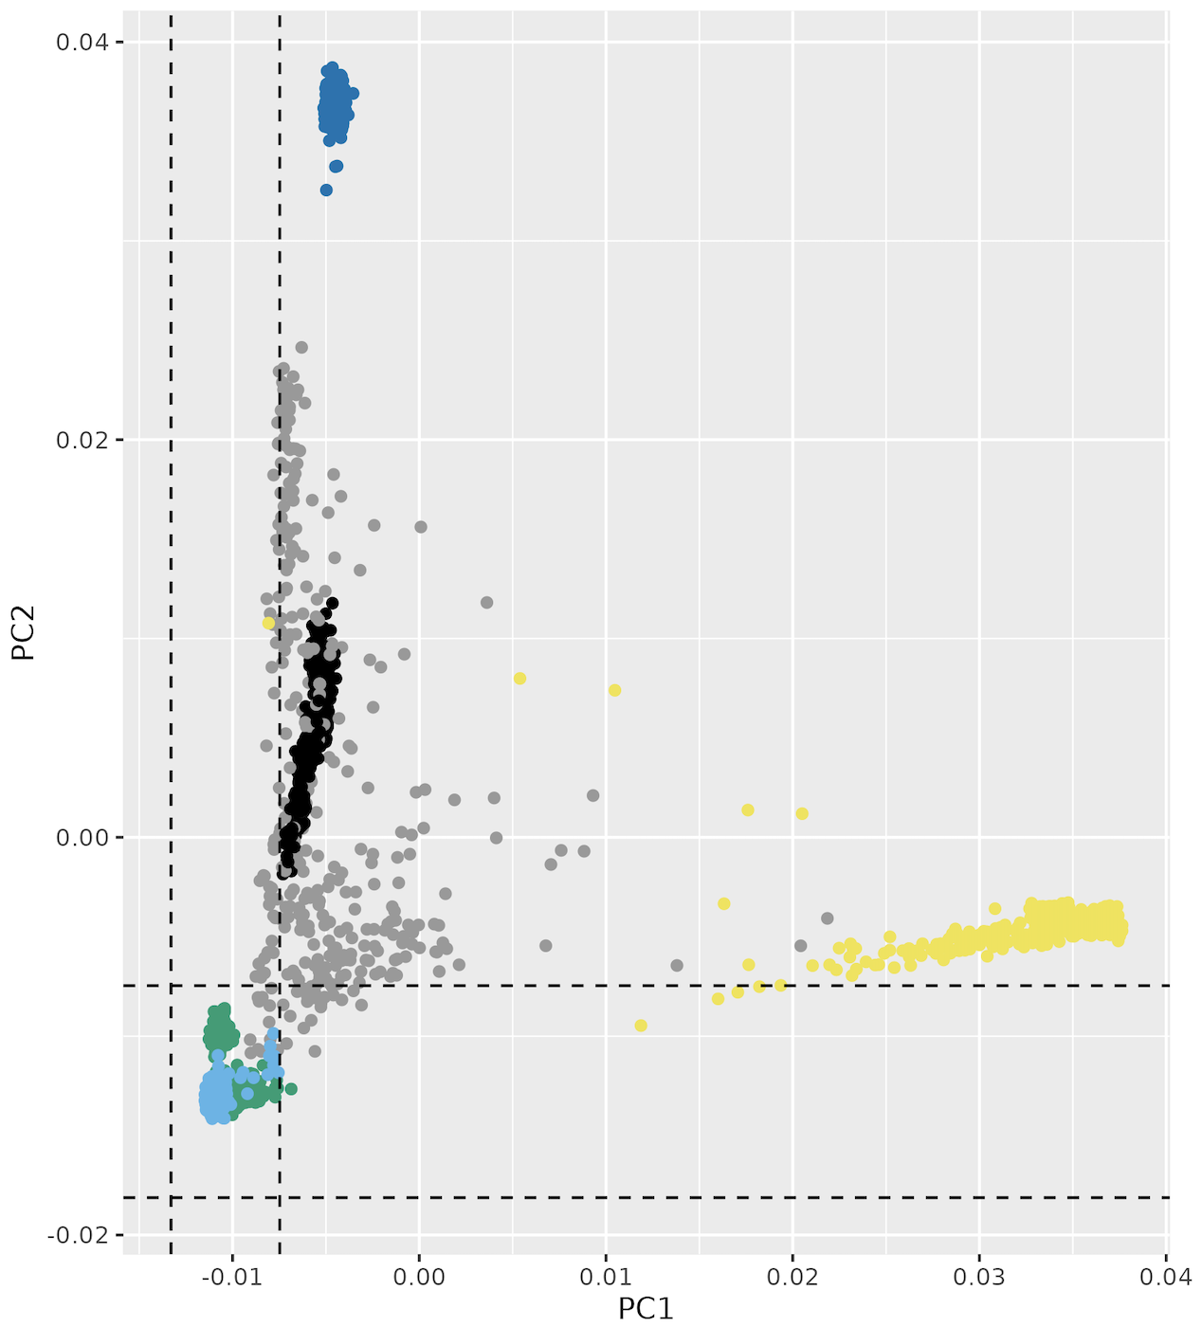
Variant calling applications
GWAS/manhattan plot
Disease/trait associated variation, e.g.
Mendelian diseases/rare diseases
GWAS/complex diseases
Cancer (somatic variants)
Favorable traits (e.g. in plants)
Evolution/population genomics, e.g:
Ancestry, migration
Biodiversity, studies of endangered species
PCA/Ancestry

Slide 4
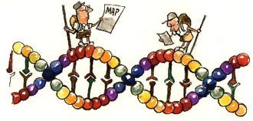
The reference genome
A reference genome is a haploid nucleic acid sequence which represents a species genome
Human genome versions
GRCh37 (hg19): 250 gaps
GRCh38 (hg38) - 2013
T2T (“gapless”) - 2022
The reference genome sequence is used as input in many bioinformatics applications for NGS data
Some annotations may only be available for specific versions, so it is not always best to use the latest version. An older version may also be used to ensure compatibility with previous studies.
You must keep track of which version of the reference genome your data was mapped to - the same version must be used in all downstream analyses

Slide 5
Alignment
REFERENCE
CCCCGCTAGCTAGCTAGCTAGCTAGCTAGCTAGCTACCCTCTTCCTTAGGGACTGTAC
SEQUENCING READ
GCTAGCTAGCTAGCTACCCT
Notes:
Alignment/mapping?.
The most commonly used aligner for NGS data at the moment is BWA, or the Burrows-Wheeler Aligner, where Burrows Wheeler transform is used for pattern matching.
What we are trying to do in its simplest form is take one of our reads and fit it to its position on the reference genome. So here we have a read from our sample and the reference genome.

Slide 6
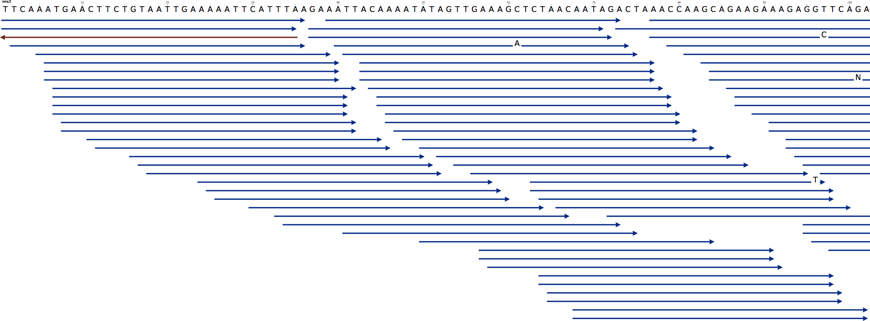
Alignment
Coverage or Depth
Notes:
But of course we didn’t have just one read. Here we have a picture with the reference genome at the top and a collection of reads aligned to it. If you have heard of the “coverage” of your sample before this is what is meant.
The coverage is the number of reads aligned to a position. The average coverage of the sample then is the average number of reads covering a position over each genomic position. For example….

Slide 7
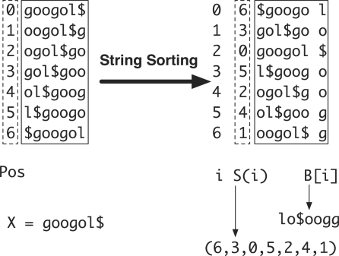
Alignment tools
Short reads (often Illumina)
BWA (Burrows-Wheeler Aligner)
Bowtie2
Long reads (e.g. PacBio, Nanopore)
minimap2
Burrows-Wheeler transform of reference genome
http://bio-bwa.sourceforge.net

Slide 8
Output from mapping - Sam format
HEADER SECTION
@HD VN:1.6 SO:coordinate
@SQ SN:2 LN:243199373
@PG ID:bwa PN:bwa VN:0.7.17-r1188 CL:bwa mem -t 1 human_g1k_v37_chr2.fasta HG00097_1.fq HG00097_2.fq
@PG ID:samtools PN:samtools PP:bwa VN:1.10 CL:samtools sort
@PG ID:samtools.1 PN:samtools PP:samtools VN:1.10 CL:samtools view -H HG00097.bam
ALIGNMENT SECTION
Read_001 99 2 3843448 0 101M = 3843625 278 TTTGGTTCCATATGAACTTT 0F<BFB<FFFBFBFFFBFBB
Read_001 147 2 3843625 0 101M = 3843448 -278 TTATTTCATTGAGCAGTGGT FBBI7IIFIB<BBBB<BBFF
Read_002 163 2 4210055 0 101M = 4210377 423 TGGTACCAAAACAGAGATAT 0IIFBFFFIIIFFIFFFBBF
Read_003 99 2 4210066 0 101M = 4210317 352 CAGAGATATAGATCAATGGA 0IIFFFIFFFIFIFIIIIIF
Start position
Quality
Reference sequence name
Sequence
Read name
(usually more complicated)
Notes:
Also covered in the ”Common file format” lecture earlier in the course
QNAME: the name of the read.
FLAG: a bitwise number describing information about the read such as mapped/unmapped read, pairing, etc.
RNAME: the reference sequence name. The value of this field is * for unmapped reads.
POS: the left most mapping position of the first matching base. It is set to zero for unmapped reads.
MAPQ: a number to indicate the mapping quality.
CIGAR: a string describing how the read aligns with the reference. It consists of one or more components. Each component comprises an operator and the number of bases which the operator applies to. Operators are: MIDNSHP=X. The following table gives an overview of these operators
MNAME: the name of the mate strand, if it is a paired read. ‘=’ means that the name is the same as RNAME.
MPOS: a number indicating the left most mapping position of the mate.
TLEN: a number set to 0 for single-segment. For paired-segments it is calculated as the number of bases from the left most mapped base to the right most mapped base.
SEQ: the read sequence as the reference. If not ‘*’ then the length of the sequence must be equal the sum of lengths of M/I/S/=/X operations in the CIGAR string.
QUAL: the read quality, same as the quality string in a fastaq format.

Slide 9
Detecting variants
Reference: ...GTGCGTAGACTGCTAGATCGAAGA...
Sample: ...GTGCGTAGACTGATAGATCGAAGA...
...GTGCGTAGACTGATAGATCGAAGA...
...GTGCGTAGACTGCTAGATCGAAGA...
...GTGCGTAGACTGCTAGATCGAAGA...
...GTGCGTAGACTGATAGATCGAAGA...
...GTGCGTAGACTGATAGATCGAAGA...
...GTGCGTAGACTGCTAGATCGAAGA...
...GTGCGTAGACTGATAGATCGAAGA...
Notes:
Variant calling is looking for positions where some number of reads disagree with the reference genome. Here for example the reference sample says the position should be a C whereas 6 of the reads say it is an A in the sample. This is also what is meant with the allelic frequency of a variant, out of 10 reads 6 are variant therefore the allelic frequency of A is 60%.
Note that this is not the same as population based allele frequencies that measures the relative frequency of an allele in a population.

Slide 10
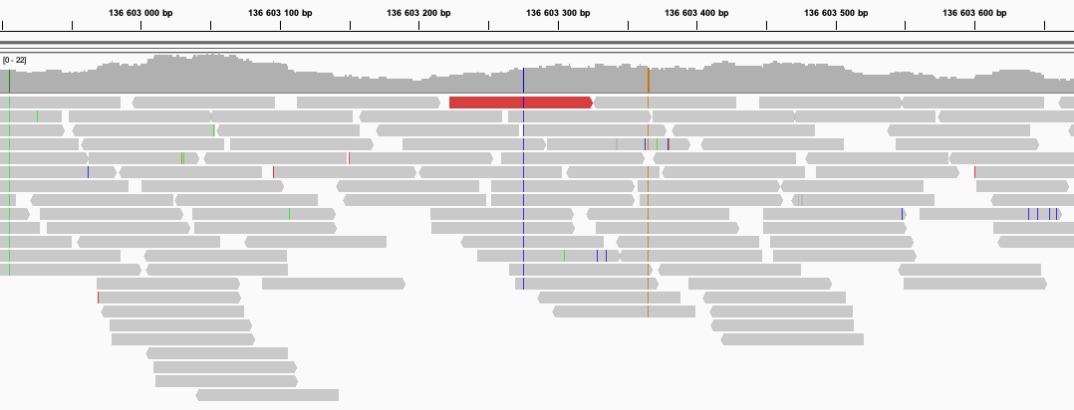
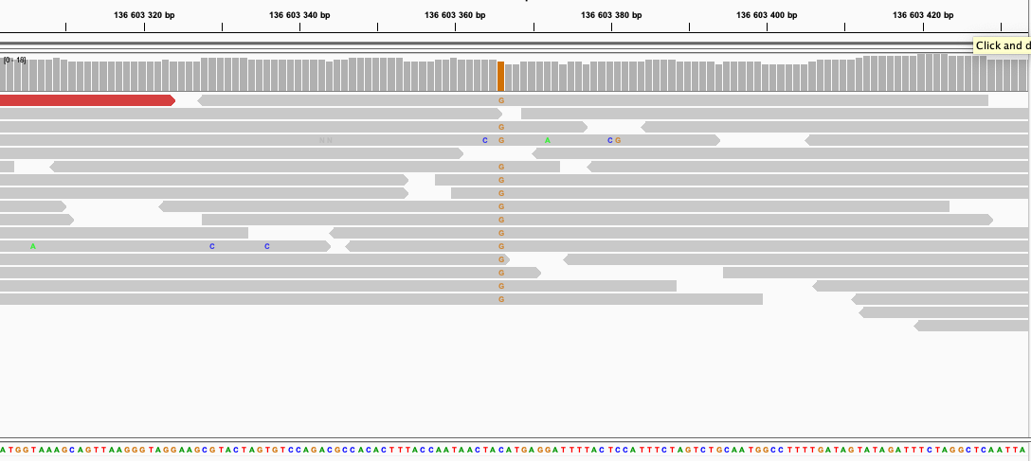
Variants in genome viewer

Slide 11
Reference- and alternative alleles
TATATCTTCCCCGCTAGCTCGCTAGCTACTTCAAAT
Reference allele
AGCTCGCTA
Alternative allele
AGCTAGCTA
Reference allele = the allele in the refence genome
Alternative allele = the allele NOT in the refence genome

Slide 12
Variant Call Format (VCF)
##fileformat=VCFv4.2
##FILTER=<ID=LowQual,Description="Low quality">
##FORMAT=<ID=AD,Number=R,Type=Integer,Description="Allelic depths for the ref and alt alleles in the order listed">
##FORMAT=<ID=DP,Number=1,Type=Integer,Description="Approximate read depth (reads with MQ=255 or with bad mates are filtered)">
##FORMAT=<ID=GT,Number=1,Type=String,Description="Genotype">
##INFO=<ID=AC,Number=A,Type=Integer,Description="Allele count in genotypes, for each ALT allele, in the same order as listed">
##INFO=<ID=AF,Number=A,Type=Float,Description="Allele Frequency, for each ALT allele, in the same order as listed">
##INFO=<ID=AN,Number=1,Type=Integer,Description="Total number of alleles in called genotypes">
##contig=<ID=2,length=243199373>
##source=HaplotypeCaller
#CHROM POS ID REF ALT QUAL FILTER INFO FORMAT HG00097
2 136220992 . G GT 30.64 . AC=1;AF=0.500;AN=2 GT:AD:DP 0/1:3,2:5
2 136226814 . GAC G 44.60 . AC=1;AF=0.500;AN=2 GT:AD:DP 0/1:4,2:6
2 136234279 . C T 102.60 . AC=1;AF=0.500;AN=2 GT:AD:DP 0/1:3,4:7
136234284 . C T 102.60 . AC=1;AF=0.500;AN=2 GT:AD:DP 0/1:3,4:7
…
Notes:
VCF files, or variant call format files, are divided into two main parts. The top, or head, of the file, with hashtag prefixed lines, is a descriptive part explaining the information given for each variant and each sample, if multiple samples exists. It also gives the date and some information from the variant caller used.
Below this are the actual variants, one line per variant.
On this slide – go through meta data and columns 1-9

Slide 13
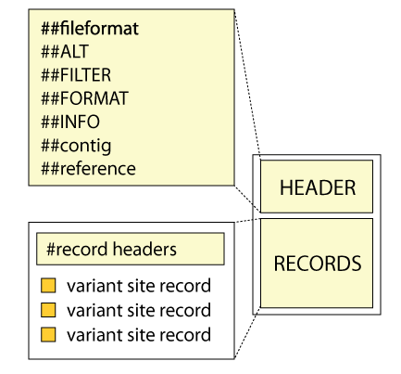
Variant Call Format (VCF)
##fileformat=VCFv4.2
##FILTER=<ID=LowQual,Description="Low quality">
##FORMAT=<ID=AD,Number=R,Type=Integer,Description="Allelic depths for the ref and alt alleles">
##FORMAT=<ID=DP,Number=1,Type=Integer,Description="Approximate read depth">
##FORMAT=<ID=GT,Number=1,Type=String,Description="Genotype">
##INFO=<ID=AC,Number=A,Type=Integer,Description="Allele count in genotypes, for each ALT allele">
##INFO=<ID=AF,Number=A,Type=Float,Description="Allele Frequency, for each ALT allele">
##INFO=<ID=AN,Number=1,Type=Integer,Description="Total number of alleles in called genotypes">
##contig=<ID=2,length=243199373>
##source=HaplotypeCaller
#CHROM POS ID REF ALT QUAL FILTER INFO FORMAT HG00097
2 136220992 . G GT 30.64 . AC=1;AF=0.500;AN=2 GT:AD:DP 0/1:3,2:5
2 136226814 . GAC G 44.60 . AC=1;AF=0.500;AN=2 GT:AD:DP 0/1:4,2:6
2 136234279 . C T 102.60 . AC=1;AF=0.500;AN=2 GT:AD:DP 0/1:3,4:7
2 136234284 . C T 102.60 . AC=1;AF=0.500;AN=2 GT:AD:DP 0/1:3,4:7

Slide 14
Multi-sample VCF
##fileformat=VCFv4.2
##ALT=<ID=NON_REF,Description="Represents any possible alternative allele at this location">
##FILTER=<ID=LowQual,Description="Low quality">
##FORMAT=<ID=AD,Number=R,Type=Integer,Description="Allelic depths for the ref and alt alleles in the order listed">
##FORMAT=<ID=DP,Number=1,Type=Integer,Description="Approximate read depth (reads with MQ=255 or with bad mates are filtered)">
##FORMAT=<ID=GT,Number=1,Type=String,Description="Genotype">
##INFO=<ID=AC,Number=A,Type=Integer,Description="Allele count in genotypes, for each ALT allele, in the same order as listed">
##INFO=<ID=AF,Number=A,Type=Float,Description="Allele Frequency, for each ALT allele, in the same order as listed">
##INFO=<ID=AN,Number=1,Type=Integer,Description="Total number of alleles in called genotypes">
##contig=<ID=2,length=243199373>
##source=CombineGVCFs
##source=GenotypeGVCFs
##source=HaplotypeCaller
#CHROM POS ID REF ALT QUAL FILTER INFO FORMAT HG00097 HG00100 HG00101
2 136045826 . G A 167.26 . AC=1;AF=0.167;AN=6 GT:AD:DP 0/0:8,0:8 0/0:13,0:13 0/1:1,5:6
2 136046443 . CGT C 129.27 . AC=3;AF=0.500;AN=6 GT:AD:DP 0/0:8,0:8 0/1:3,1:4 1/1:0,4:4
2 136047387 . T C 186.27 . AC=1;AF=0.167;AN=6 GT:AD:DP 0/0:6,0:6 0/0:16,0:16 0/1:4,6:10
2 136048649 . C G 127.26 . AC=1;AF=0.167;AN=6 GT:AD:DP 0/0:13,0:13 0/0:9,0:9 0/1:1,4:5
Notes:
VCF files, or variant call format files, are divided into two main parts. The top, or head, of the file, with hashtag prefixed lines, is a descriptive part explaining the information given for each variant and each sample, if multiple samples exists. It also gives the date and some information from the variant caller used.
Below this are the actual variants, one line per variant.
Now let´slook at each part a little closer.

Slide 15
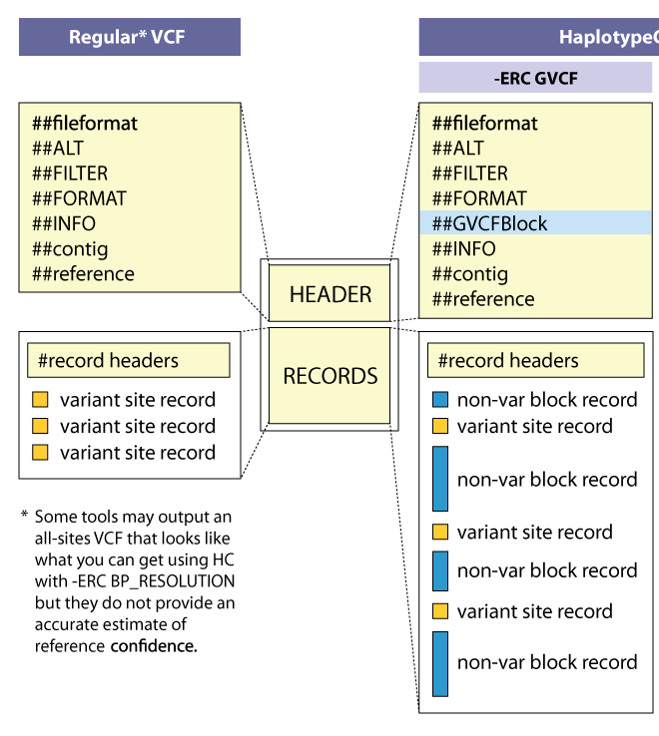
GVCF Files
HaplotypeCaller GVCF
GVCF has records for all sites, whether there is a variant call there or not
The records include an estimation of how confident we are in that the sites are homozygous-reference or not
Adjacent non-variant sites merged into blocks
Notes:
For joint genotyping projects we use a different kind of VCF file.
A gVCF file has the same format as a VCF file but it has information for all sites, not just variants. There are two kinds of gVCF files, the older ones had individual records for each site but this is space inefficient.
The new ones have individual variant records for variant sites, but the non-variant sites are grouped together into non-variant block records that represent intervals of sites for which the genotype quality (GQ) is within a certain range or band.
http://gatkforums.broadinstitute.org/wdl/discussion/4017/what-is-a-gvcf-and-how-is-it-different-from-a-regular-vcf
In the so-called GVCF mode used for scalable variant calling in DNA sequence data, HaplotypeCaller runs per-sample to generate an intermediate genomic gVCF (gVCF), which can then be used for joint genotyping of multiple samples in a very efficient way, which enables rapid incremental processing of samples as they roll off the sequencer, as well as scaling to very large cohort sizes (e.g. the 92K exomes of ExAC).

Slide 16
Variant callers
Selection of tools
Germline variants
HaplotypeCaller, FreeBayes, BCFtools, DeepVariant
Somatic variants
Mutect2, Strelka2
Which tool should I use?
GATK HaplotypeCaller is used in the lab – commonly used for variant calling in human
Non-model organisms?
Notes:
Organism, ploidy (diploid, polyploid, pooled…), sequencing depth, number of samples, aim of study, compute resources…
In the lab we will use HaplotypeCaller which is a widely used tool, Optimised for detecting germline variants in diploid species (human)

Slide 17
Variant filtration
Variant calling with e.g. HaplotypeCaller is designed to be sensitive
Important to apply filters to limit false positives
Examples of filters on information in the VCF file
QUAL < 30.0
Depth < 10
VQSR is a filtering method based on machine learning
Recommended when there is a lot of data and
a list of known variants from the species

Slide 18
Workflows
Intermediary_file_1.txt
Process 2
Intermediary_file_2.csv
input_data.txt
Process 1
Process 3
output.pdf
Notes:
An importand part of bioinformatics work is creating workflows, i.e. putting tools together in the right order.

Slide 19
Workflow conventions
Create a new output file in each process
Do not overwrite the input file
Use informative file names
Include information about the process + sample
Correct name extension e.g. .bam, .vcf, ...
Notes:
In order to keep track of all the processes you will run during the exercise it is important to organize your data.
Use good file names. For example “sample.fastq”.
In each analysis step you define an input file and an output file. ALWAYS create a new output file, i.e. do not overwrite the input file.
It is a good practice to include the name of the analysis step (or shortened) in the output file name.

Slide 20
Example: Basic workflow, one sample
HG00097.bam
VariantCalling
HG00097_1.fastq
HG00097_2.fastq
Alignment
HG00097.vcf
Reference.fasta

Slide 21
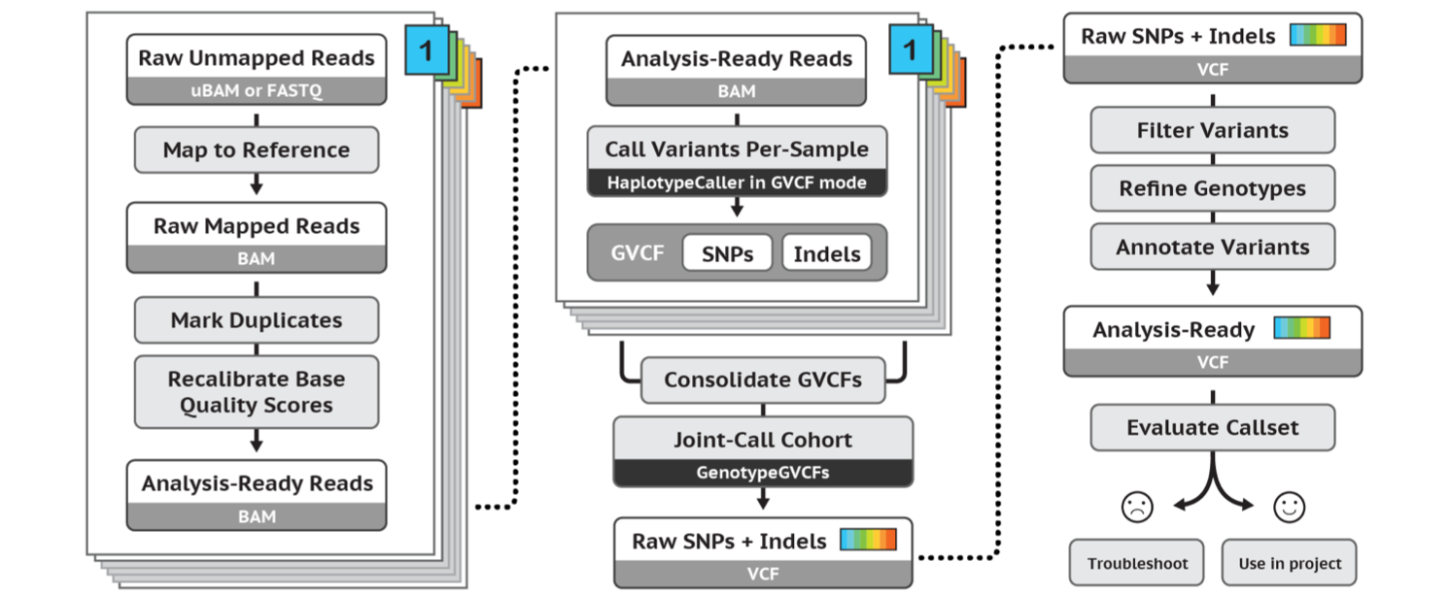
Refined workflow: GATK’s best practices workflow for germline short variant discovery
https://software.broadinstitute.org/gatk/best-practices/
Notes:
But before we dive in to alignment I will mention that this is where the recommendations of the Broad institute best practices start. A guide that they have maintained pretty-well for several years where they recommend tools and setting to use for a standard analysis. I recommend that someone setting up a bioinformatics workflow or wanting to compare what has been done with their data and what is currently considered best practice be intimately aware of these recommendations.

Slide 22
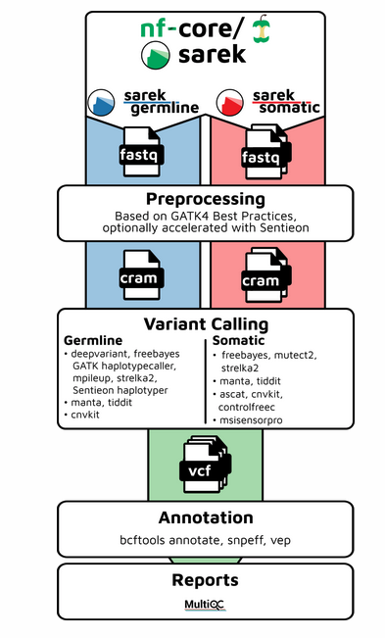
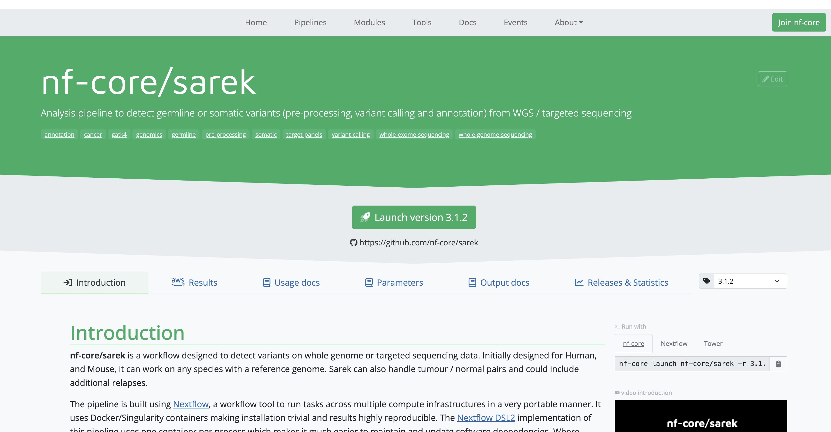
Nf-core variant calling workflow: Sarek
https://nf-co.re/sarek/3.4.2/

Slide 23
Overview of lab
Part1: Basic variant calling for one sample
Part2: Variant calling in cohort (multiple samples)
Part3: Use bash script
Extra material (part4): GATK’s Best practices
Notes:
During the course of this talk I hope to explain some core concepts around NGS data such as the basics surrounding what the reference genome, variants and paired-end data is. This will be background information for the main point which is to cover the main concepts of a typical best practice workflow, or as some people call it a “pipeline”, where we take the raw reads in fastq format all the way to variants. I will dive a little deeper into the output from variant calling, the VCFs or Variant Call Format, what joint genotyping is and the principal of annotating and filtering the variants.
As with anything there is more to know about each of these subjects and I encourage you to go deeper as needed.

Slide 24
Data
3 samples (from 1000 genomes)
Low coverage WGS data
Small region on chromosome 2
About the samples:
https://www.internationalgenome.org/data-portal/sample

Slide 25
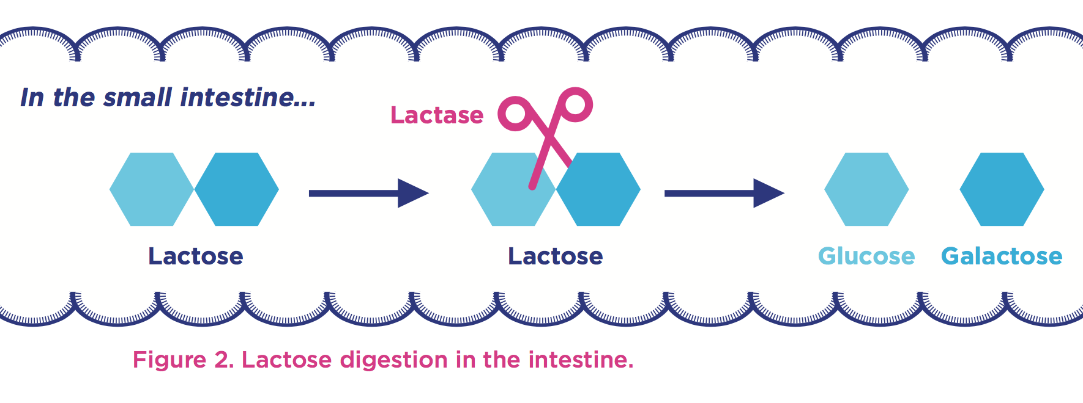
The Lactase enzyme
All mammals produce lactase as infants
Some human produce lactase in adulthood
Genetic variation upstream of the LCT gene cause the lactase persistent phenotype (lactose tolerance)
Notes:
Most people are born with the ability to digest lactose, the major carbohydrate in milk and the main source of nutrition until weaning.
Lactase is an enzyme expressed in the small intestine.
Cuts the lactose molecule into one glucose and one galactose molecule.
Lactase is encoded by the LCT gene, located on chromosome 2.

Slide 26
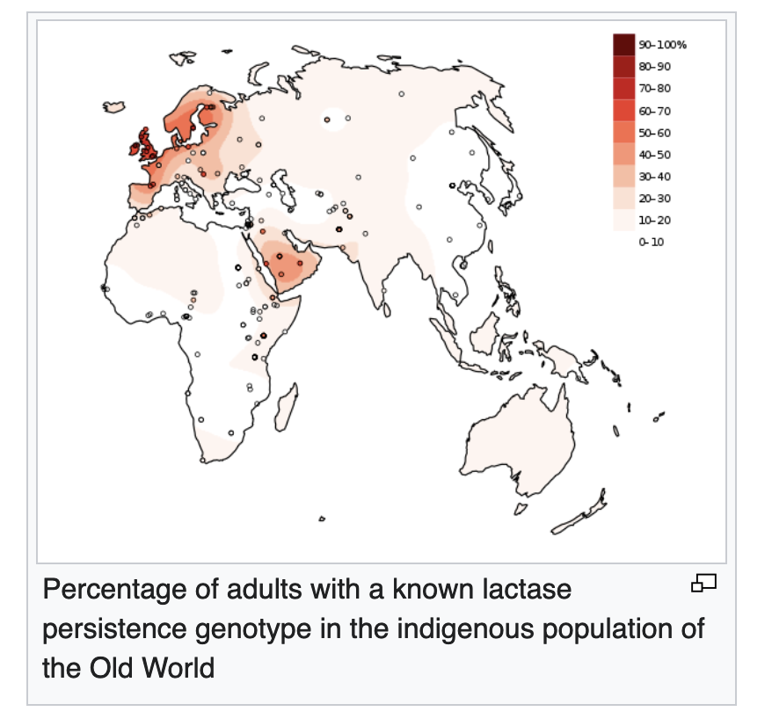
The Lactase enzyme
Notes:
Most people are born with the ability to digest lactose, the major carbohydrate in milk and the main source of nutrition until weaning.
Lactase is an enzyme expressed in the small intestine.
Cuts the lactose molecule into one glucose and one galactose molecule.
Lactase is encoded by the LCT gene, located on chromosome 2.

Slide 27
Part1: Basic Variant Calling in one sample
HG00097.bam
HaplotypeCaller
HG00097_1.fastq
HG00097_2.fastq
BWA mem
HG00097.vcf
FASTQ files
Alignment
SAM file
BAM file
Variant calling
VCF file

Slide 28
File indices
Most large files we work with need indices
reference genome (.fasta)
aligned reads (.bam)
Variants (.vcf)
Allows efficient access to the large file
The index is stored in a file (or several files)
Different indices for different file types
.fasta.fai, .bam.bai, .vcf.idx, etc
BWA index (several files)

Slide 29
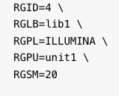
ReadGroups
Tags that mark which sample and sequencing run each read comes from
RGID: unique identifier of sequencing run
RGSM: sample name used in the vcf file
RGLB – library id, used to get correct duplicate marking (for example)

Slide 30
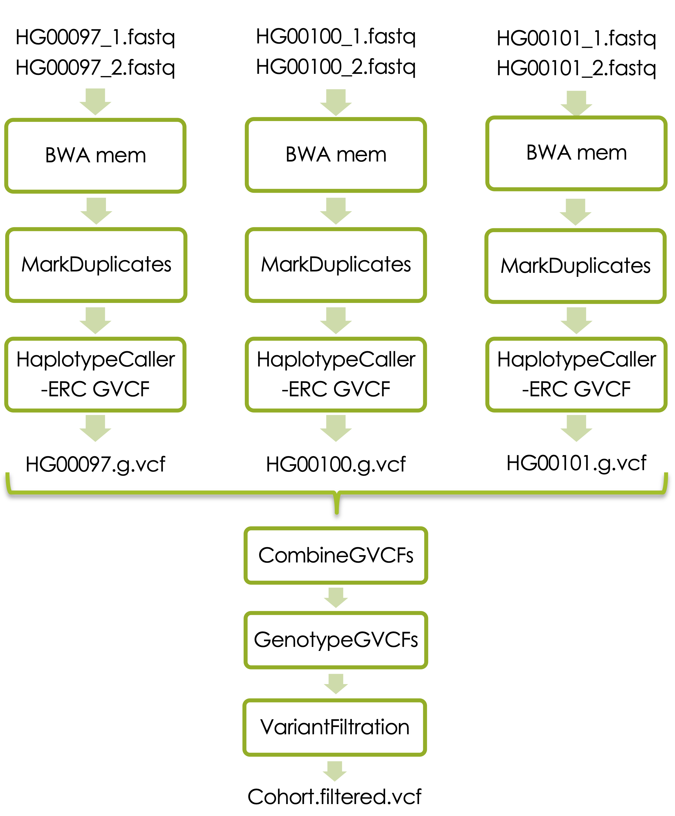
Part2: Basic variant calling in cohort

Slide 31
Basic variant calling in cohort
Mark duplicates
Joint genotyping
Variant filters
Notes:
Add marking of duplicate reads (PCR and optical)
Add variant calling in multiple samples and variant filtration

Slide 32
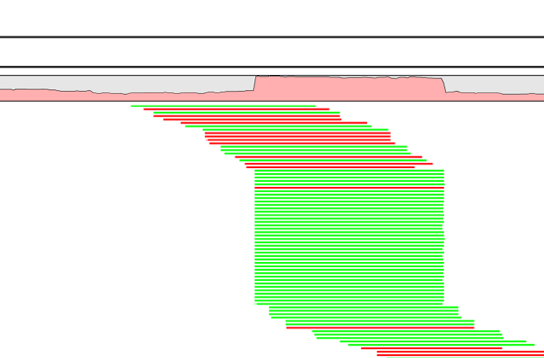
Duplicate reads
PCR duplicates - library preparation
Optical duplicates - sequencing
Can give false allelic ratios of variants
Should often be removed/marked
Picard MarkDuplicates
Samtools dedup
Notes:
One tool for this is picards MarkDuplicates.
Occur PCR
Copies same fragment goto different flowcells
High library complexity is good
Don’t add information
Optical duplicates
Less talked about
One flowcell cluster
Incorrectly identified on several cells
Amplicon
Duplicates typically arise during PCR amplification of the fragments with adapters. We are intentionally creating multiple copies of each original genomic DNA molecule so that you have enough of them. The PCR duplicates occur when two copies of the same original molecule get onto different areas of the flowcell. A greater amount of starting material, often termed as having a high complexity library, is a good indicator of not having a big problem with duplicates.
And duplicates don’t give any additional information, as you can see here, what we want is reads slightly off from eachother, so we know that they are adding new information. You can also choose to just mark the duplicates rather than remove them entirely as many variant callers can ignore reads marked as duplicates. This gives you the option later to perform variant calling with and without duplicates and compare the results.
Finally, during some kinds of sequencing, such as amplicon sequencing, you tend to recommend not removing duplicates as there will be many duplicates by design. So keep that in mind.
“optical duplicates are sequences from one flow cell cluster, that are (incorrectly) identified by software to be from multiple adjacent clusters. ”

Slide 33
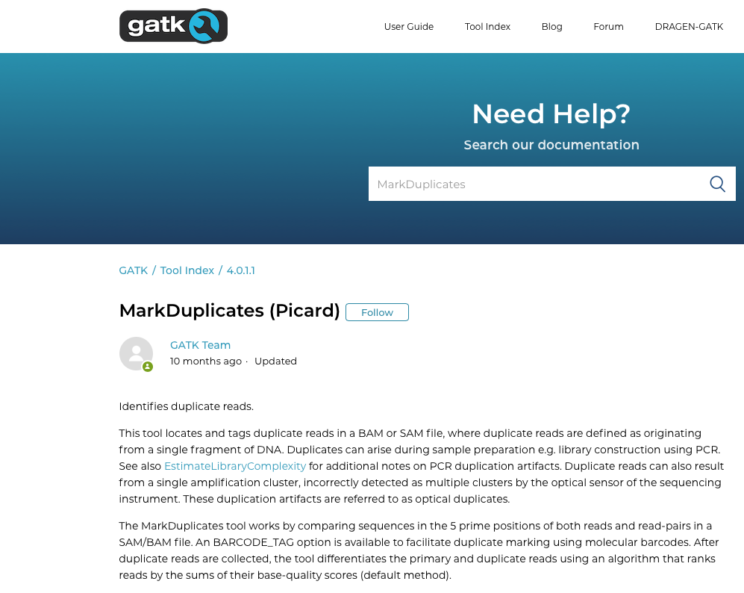
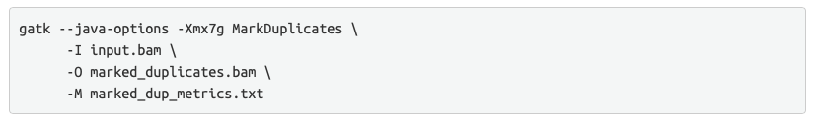

Slide 34
Variant filtration
Variant calling with HaplotypeCaller is designed to be sensitive
Apply filters to limit false positives
Advanced filtration (VQSR) requires more data than we have here
Here: “Hard filters” - select cutoffs on e.g. quality or read coverage
Cutoffs can be selected after viewing quality score distributions
Notes:
A typical scenario requiring manual filtration is small cohort callsets, e.g. less than thirty exomes.

Slide 35
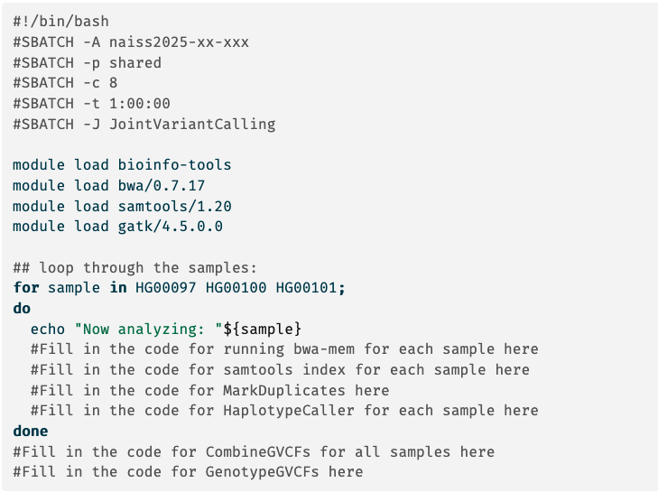
Part3: Bash script for variant calling

Slide 36
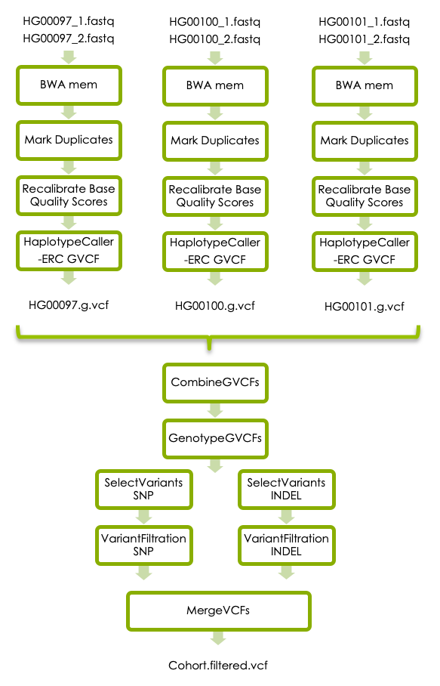
Extra lab (Part4): GATK’s best practises
Notes:
Day2 ?

Slide 37

GATK best practices for short variant discovery
https://gatk.broadinstitute.org

Slide 38
GATK’s best practices workflow for germline short variant discovery
https://software.broadinstitute.org/gatk/best-practices/
Notes:
this is where the recommendations of the Broad institute best practices start. A guide that they have maintained pretty-well for several years where they recommend tools and setting to use for a standard analysis. I recommend that someone setting up a bioinformatics workflow or wanting to compare what has been done with their data and what is currently considered best practice be intimately aware of these recommendations.
They no longer recommend indel realignment, as it is performed on the fly at the variant calling stage. It is good to note that this resource exists, as it is definitely something you should be looking at when running a different variant calling pipeline or when the bam files are needed for other purposes.

Slide 39
Base Quality Score Recalibration (BQSR)

Slide 40
Base Quality Score Recalibration (BQSR)
During base calling, the sequencer estimates a quality score for each base. These are the quality scores present in the fastq files
Systematic (non-random) errors in base quality score estimation can occur
due to the physics or chemistry of the sequencing reaction
manufacturing flaws in the equipment
etc
Can cause biases in variant calling
Base Qualtiy Score Recalibration helps to calibrate the scores so that they correspond to the real per-base sequencing error rate (phred scores)
Notes:
Base Quality Score Recalibration basically detects systematic errors made by the sequencer when it estimates the quality score of each base call, which is basically how confident the machine was that the called base is correct.
Some of these errors are due to the physics or the chemistry of how the sequencing reaction works, and some can be due to manufacturing flaws in the equipment.
The tool checks the covariation between Reported quality score, the position within the read and the preceding and current nucleotide observed by the sequencing machine to find non-random discrepancies that lead to the score being adjusted.
These systematic technical errors, leading to over- or under-estimated base quality scores in the data.

Slide 41
Filter variants
https://software.broadinstitute.org/gatk/best-practices/
Germline short variant discovery (SNPs + Indels)
Notes:
But before we dive in to alignment I will mention that this is where the recommendations of the Broad institute best practices start. A guide that they have maintained pretty-well for several years where they recommend tools and setting to use for a standard analysis. I recommend that someone setting up a bioinformatics workflow or wanting to compare what has been done with their data and what is currently considered best practice be intimately aware of these recommendations.
//A recent change has been made where they no longer recommend indel realignment, as it is performed on the fly at the variant calling stage. It is good to note that this resource exists, as it is definitely something you should be looking at when running a variant calling pipeline as it is needed in some cases.

Slide 42
Filter variants
Variant quality score recalibration (VQSR):
Machine learning algorithm trained to recognise ”likely false” variants
For large data sets ( >1 WGS or >30WES samples) - Use VQSR when possible!
“Hard” filters:
For smaller data sets
Filters on information in the VCF file using set cutoffs
For example: Flag variants with ”QD < 2.0”
Notes:
A typical scenario requiring manual filtration is small cohort callsets, e.g. less than thirty exomes.

